Slide 1
W4153 – Cloud Computing Lecture 2: IaaS, REST, BLOBs, Design Patterns
© Donald F. Ferguson, 2024

Slide 2
W4153 – Cloud Computing Lecture 2: IaaS, REST, BLOBs, Design Patterns
We will start in a few minutes.
© Donald F. Ferguson, 2024

Slide 3

Contents
3 | W4153-24F-L2-REST-Microservices-IaaS © Donald F. Ferguson, 2024

Slide 4
Contents
Infrastructure-as-a-Service
Concepts
AWS realization
Deploying first VM
Microservices
Concepts and characteristics
Architecture best practices: 12-Factor Apps, SOLID
Design patterns
REST
Concepts
A basic implementation example
BLOBs and static content
Concepts
AWS realization
Deploying static content
Next steps -- project teams, deploying on cloud, … …

Slide 5
Infrastructure-as-a-Service
5 | W4153-24F-L2-REST-Microservices-IaaS © Donald F. Ferguson, 2024

Slide 6
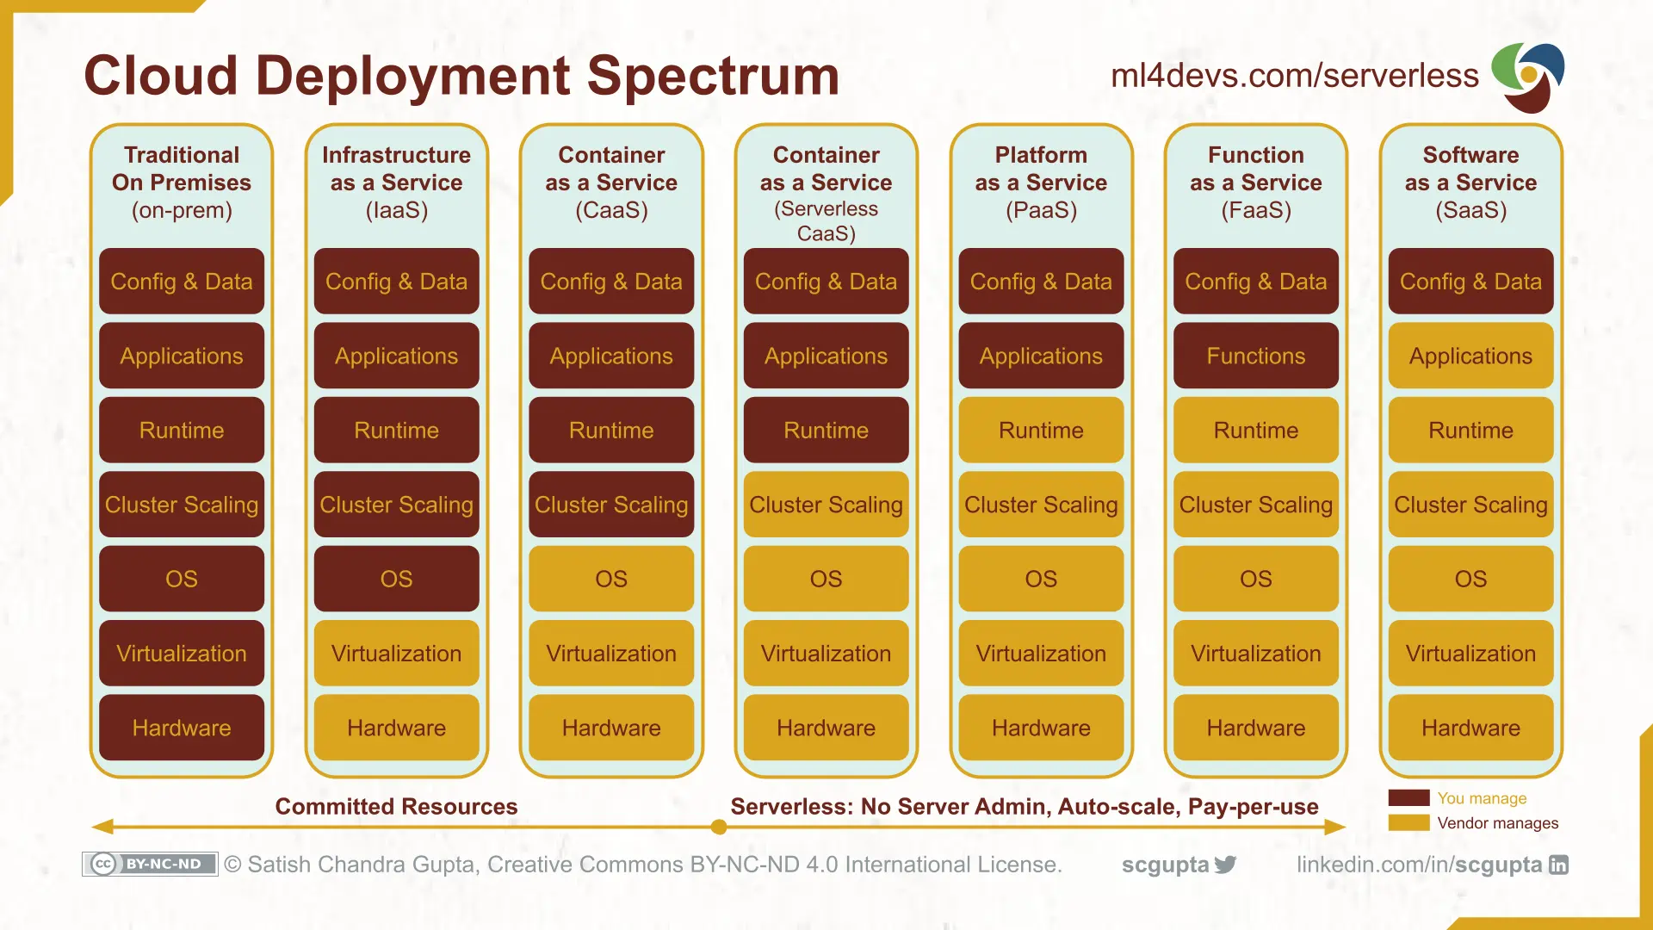
Cloud Layers

Slide 7
Virtualization
Introduction
7 | W4153-24F-L2-REST-Microservices-IaaS © Donald F. Ferguson, 2024

Slide 8
Virtualization, Virtual Machines
"In computing, a virtual machine (VM) is an emulation of a computer system. Virtual machines are based on computer architectures and provide functionality of a physical computer. Their implementations may involve specialized hardware, software, or a combination." (https://en.wikipedia.org/wiki/Virtual_machine)
On my Mac laptop, I used to have:
One host operating system and HW (Mac, MacOS)
Two hypervisors (Virtual Box, VMWare Fusion)
Two guest OS: Windows 10, Debian Linux
Then, …
Apple transitioned to ARM
Broadcom bought VMWare
Then people started asking, “Why do you want to do this grandpa?”

Slide 9
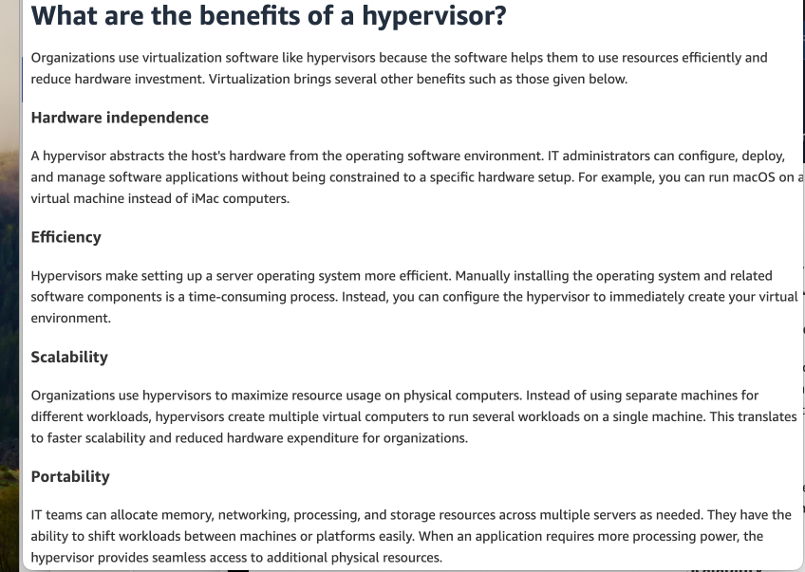
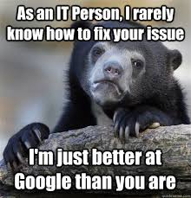

Hypervisor
“A hypervisor, also known as a virtual machine monitor (VMM) or virtualizer, is a type of computer software, firmware or hardware that creates and runs virtual machines. A computer on which a hypervisor runs one or more virtual machines is called a host machine, and each virtual machine is called a guest machine. The hypervisor presents the guest operating systems with a virtual operating platform and manages the execution of the guest operating systems.” (https://en.wikipedia.org/wiki/Hypervisor)
Instructor’s Note:
If I let you use Google, Stack Overflow, GitHub, … … to write code, solve problems, …
I get to use Google, Stack Overview, GitHub, … … to make my lecture slides.

Slide 10
Virtual Machines on Physical Machines
Note:
I did not replicate this setup on my new Mac.
Contrary to what you might think, I do have other work to do.
I have Ubuntu on top of UTM. But, I cannot bridge the network!

Slide 11
Virtual Machines on Physical Machines
I went down the VMWare Fusion, UTM, Ubuntu, … Rabbit Hole and wasted hours trying to make this useless example work. Summary: IaaS uses VMs. VMs are cool. Do not work about VMs. They are magic.
Note:
I did not replicate this setup on my new Mac.
Contrary to what you might think, I do have other work to do.
I have Ubuntu on top of UTM. But, I cannot bridge the network!

Slide 12
Virtual Private Cloud
“A virtual private cloud (VPC) is an on-demand configurable pool of shared resources allocated within a public cloud environment, providing a certain level of isolation between the different organizations (denoted as users hereafter) using the resources. ... ...
The isolation between one VPC user and all other users of the same cloud (other VPC users as well as other public cloud users) is achieved normally through allocation of a private IP subnet and a virtual communication construct (such as a VLAN or a set of encrypted communication channels) per user.” (https://en.wikipedia.org/wiki/Virtual_private_cloud)
A virtual machine on my laptop has a virtual adaptor connected to a real network.
A virtual private cloud is a set of virtual machines connected to a virtual network.
All cloud providers support virtual private clouds with the same concepts, but with slightly different realizations and terms.

Slide 13
Virtual Private Cloud and VM
Introduction
13 | W4153-24F-L2-REST-Microservices-IaaS © Donald F. Ferguson, 2024

Slide 14
Some Terminology (AWS)
There are several online tutorials. Understanding some terms is useful.
AWS has the concept of a Region, which is a physical location around the world where we cluster data centers. We call each group of logical data centers an Availability Zone. Each AWS Region consists of multiple, isolated, and physically separate AZ's within a geographic area.
An Availability Zone (AZ) is one or more discrete data centers with redundant power, networking, and connectivity in an AWS Region. AZs give customers the ability to operate production applications and databases that are more highly available, fault tolerant, and scalable than would be possible from a single data center.
A VPC is a virtual private cloud, which works like a private network to isolate the resources within it.
A route table contains a set of rules, called routes, that are used to determine where network traffic is directed.
A subnet is a defined set of network IP addresses that are used to increase the security and efficiency of network communications. You can think of them like postal codes, used for routing packages from one location to another.
A network interface represents a virtual network card. The network interface displays its network interface ID, subnet ID, VPC ID, security group, and the Availability Zone that it exists in.
A security group is a set of rules that controls the network access to the resources it is associated with. Access is permitted only to and from the components defined in the security group's inbound and outbound rules.
An internet gateway is a VPC component that allows communication between instances in your VPC and the internet.
A VPC endpoint enables you to privately connect your VPC to supported AWS services without using public IP addresses.
All clouds have similar concepts but with different names.

Slide 15
Let’s Build our First VPC and VM
Well, actually, let’s not do that for now.
We are just going to create our first virtual machine.
But,
The virtual machine is in my “default” VPC.
Setting up and using the VM requires understanding some of the concepts.
We can mostly just use the EC2 wizard for now.
I am going to set up a VM to host our first cloud application
I will deploy the application and supporting SW.
Basic tasks:
Configure and deploy VM, SSH credentials, security group rules.
Install supporting software: Python, MySQL.
Run “Hello World” test.
There is an example in https://github.com/donald-f-ferguson/W4153-Hello-World-FastAPI.git

Slide 16
What Comes/Would Come Next?
We did the VM work “manually,” and this was:
Tedious
Complex
An organization typically has two “teams:”
Develop team
Infrastructure team
The infrastructure team has a “library” of prebuilt/previously built environments. Provides automation tools to simplify iterative development and deployment.
A development team can:
Create a new instance of a predefined environment.
Request creation or modification of an environment.
Terms in this space are continuous integration/continuous delivery and DevOps.
We do things manually in this course for education/understanding purposes. We will start automating in a couple of lectures.

Slide 17
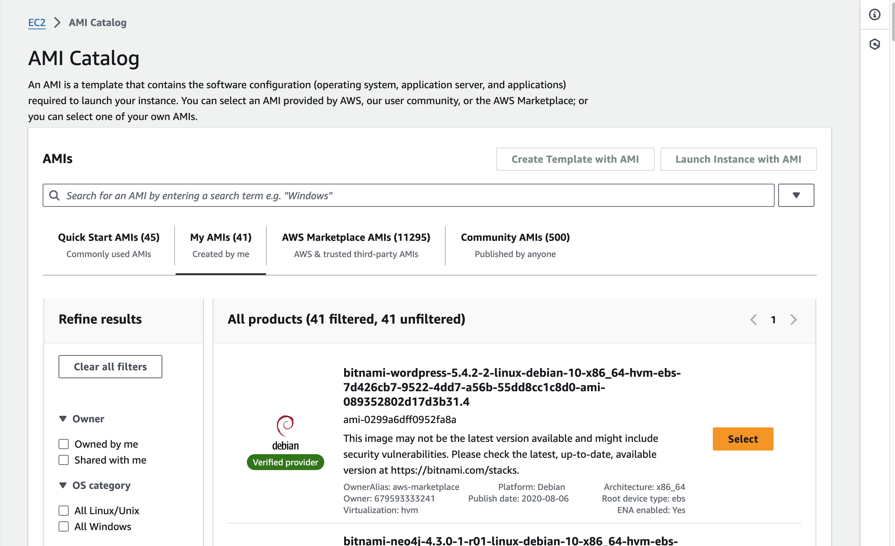
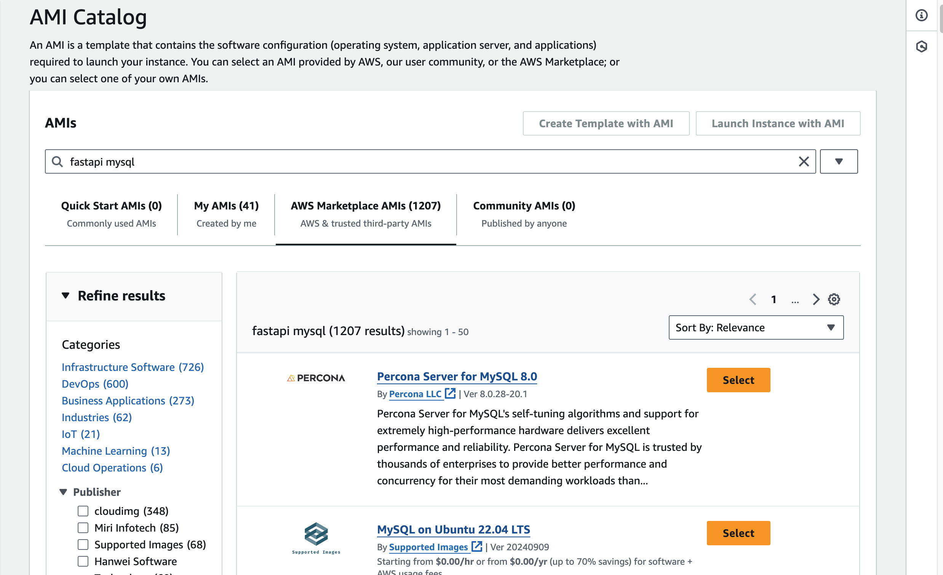
Prebuilt Images
There is usually an ecosystem of prebuilt versions/images that you can tailor.
There are also often prebuilt automation scripts that you can use in deployment workflows.
Teams/organizations build up “libraries” of “reliable, well-designed” environments.
We will get some experience with this process.

Slide 18
Microservices (Continued)
18 | W4153-24F-L2-REST-Microservices-IaaS © Donald F. Ferguson, 2024

Slide 19
Reminder
Introduction
19 | W4153-24F-L2-REST-Microservices-IaaS © Donald F. Ferguson, 2024

Slide 20
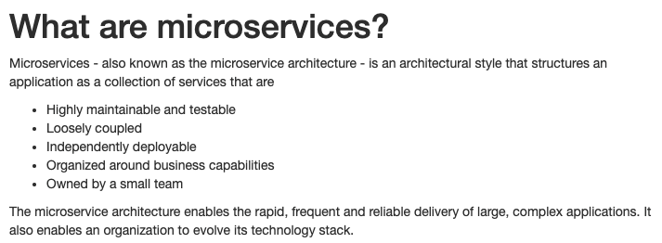
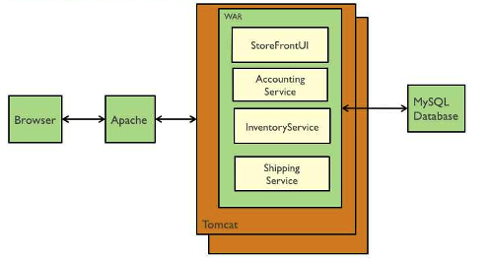
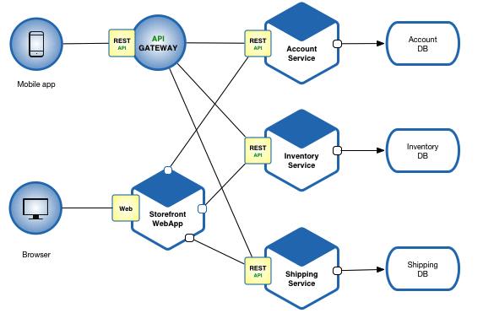
Microservices (https://microservices.io/index.html)
Microservice benefits relative to monoliths are hard to understand without having developed and maintained monoliths.
Cars are “cool.” Cars are totally, super cool if you had to go into town using a horse drawn carriage.
Microservices Architecture
Monolithic Architecture

Slide 21
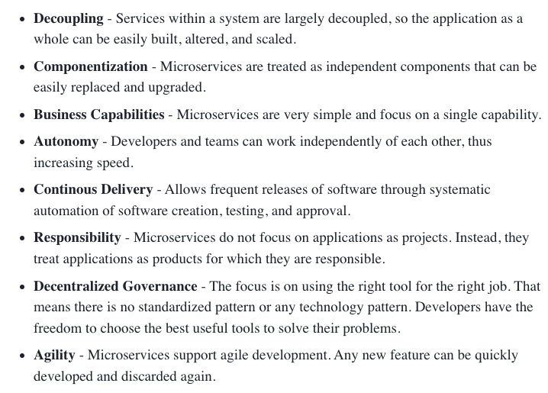
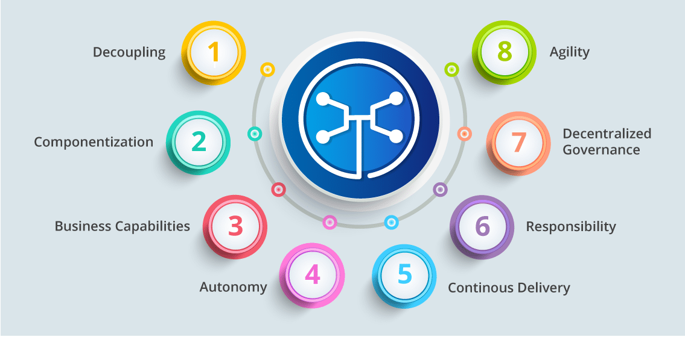
Microservice Characteristics (https://dzone.com/articles/what-is-microservices-an-introduction-to-microserv)
Microservice Characteristics
Event based --> Loose coupled

Slide 22
A student asked something like, ”Is there more to microservices than just breaking things into parts?” ➔ Design patterns and Design Principles
Introduction
22 | W4153-24F-L2-REST-Microservices-IaaS © Donald F. Ferguson, 2024

Slide 23
Design Patterns
“In software engineering, a software design pattern is a general, reusable solution to a commonly occurring problem within a given context in software design. It is not a finished design that can be transformed directly into source or machine code. Rather, it is a description or template for how to solve a problem that can be used in many different situations. Design patterns are formalized best practices that the programmer can use to solve common problems when designing an application or system.” (https://en.wikipedia.org/wiki/Software_design_pattern)
We will cover design patterns in several aspects:
SW patterns for building code “in microservices.” How do you write the code?
Architecture patterns for microservices and composition into complex solutions.
Cloud architecture patterns: how do you solve problems with cloud technology.
Data modeling and data access patters.
… …

Slide 24
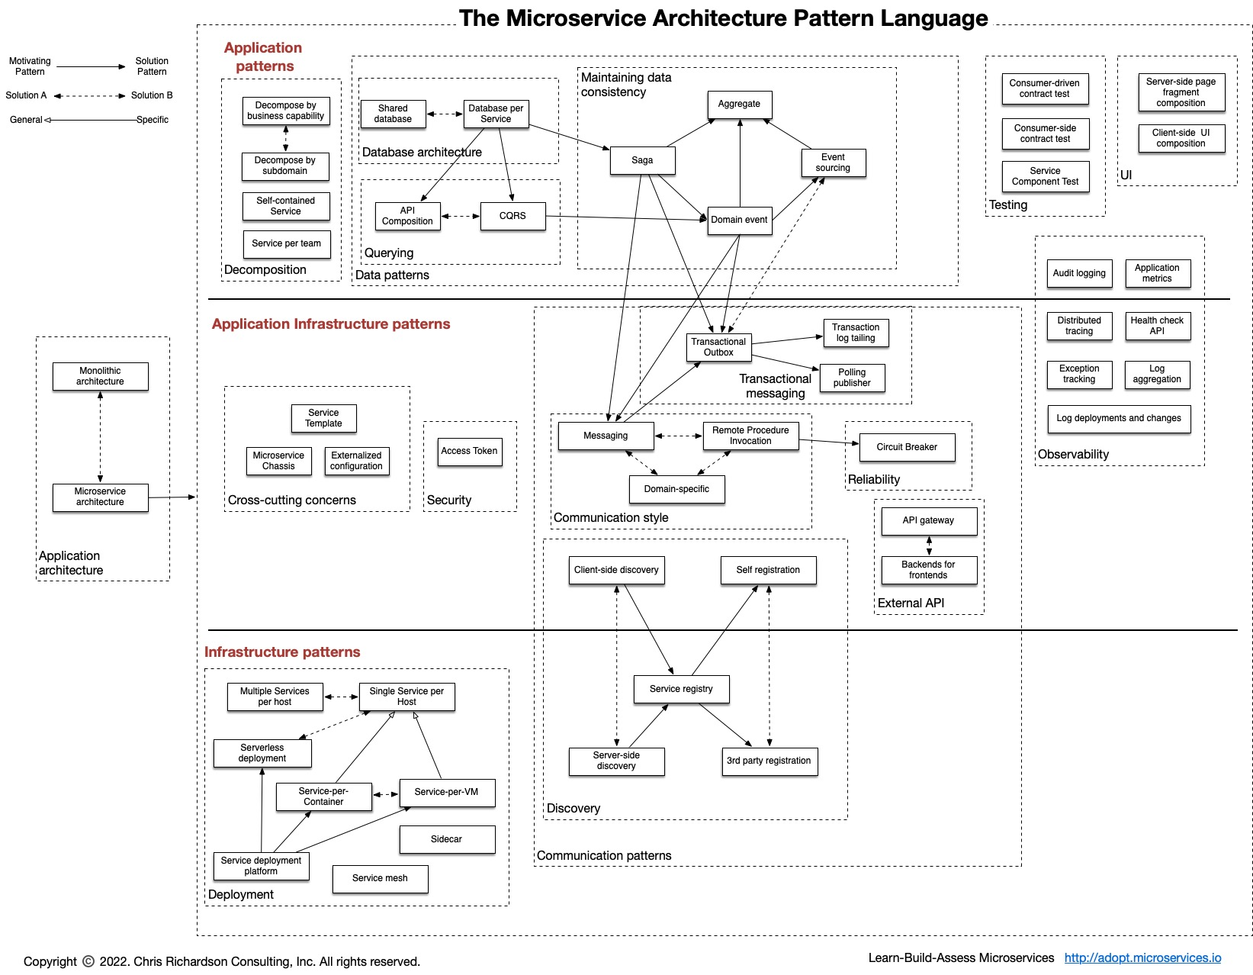
Microservice Pattern Language (One Perspective)
If you are trying to solve a problem or implement something,
You are probably not the first person to do so.
Probably a lot of other people have tried, failed and then learned.
Ask Google or ChatGPT what others do.
A knowledge of basic design patterns is useful to guide architecture/implementation decisions.
We will cover when encountering tasks and challenges.
https://microservices.io/patterns/index.html

Slide 25
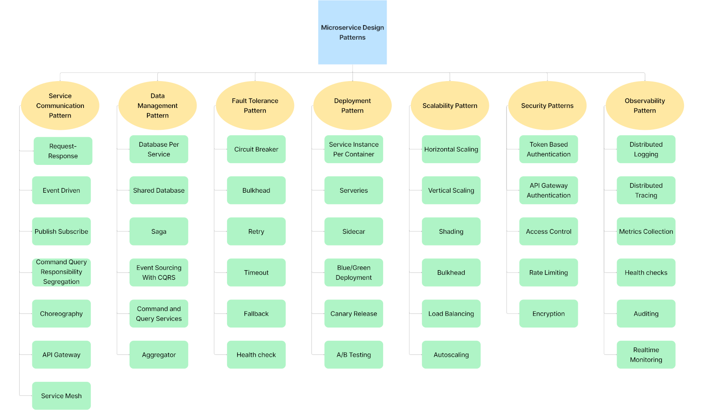
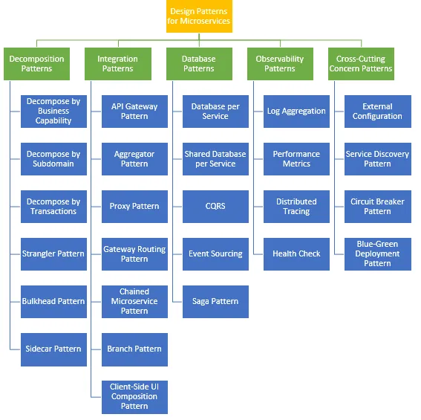
There are a Lot of Design Patterns
https://blog.beehyv.com/design-patterns-in-microservices-enhancing-scalability-flexibility-and-maintainability-197e499a575b
https://medium.com/@madhukaudantha/microservice-architecture-and-design-patterns-for-microservices-e0e5013fd58a

Slide 26
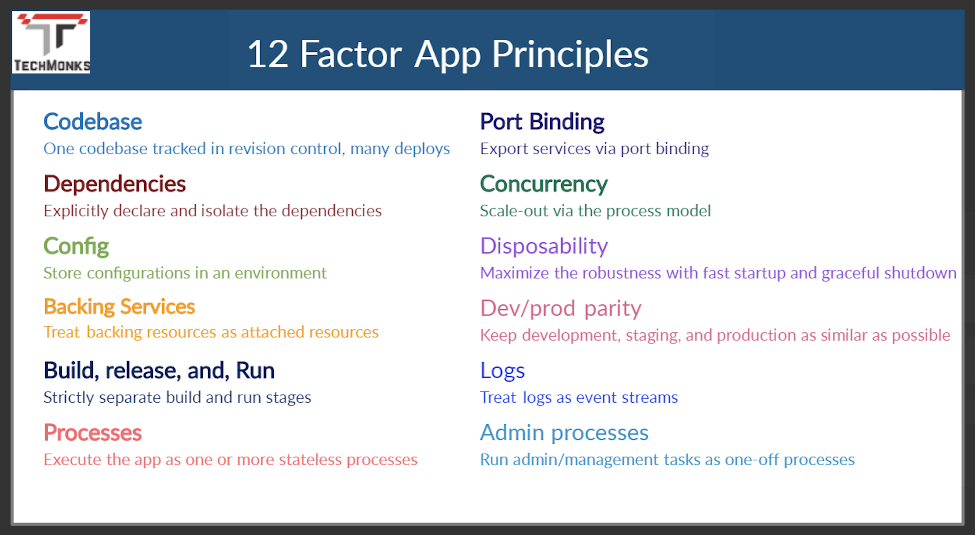
12 Factor Applications
https://dzone.com/articles/12-factor-app-principles-and-cloud-native-microser

Slide 27
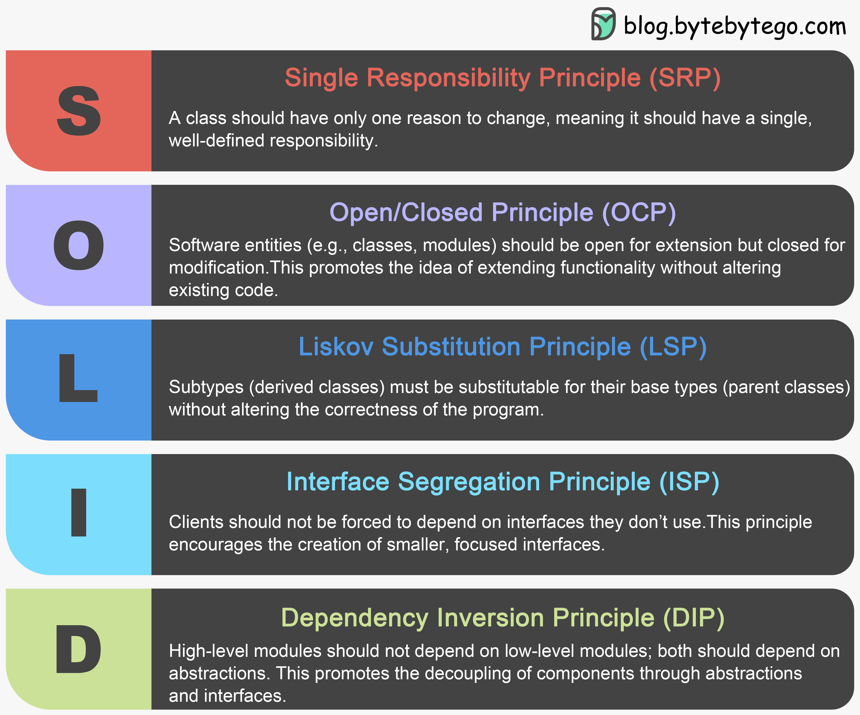
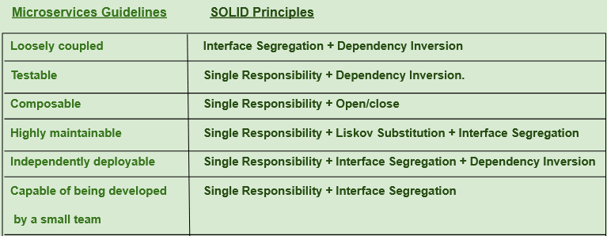
SOLID Principles
https://medium.com/@saurabh.engg.it/microservices-designing-effective-microservices-by-following-solid-design-principles-a995c3a033a0
This is a good overview article, and we will see patterns in later lectures.
This slide and the preceding slides could have been a 60 slide presentation.
If you put 3 SW architects into a room, you will get 15 design principles and patterns.
Use common sense.

Slide 28
My First Steps
Introduction
28 | W4153-24F-L2-REST-Microservices-IaaS © Donald F. Ferguson, 2024

Slide 29
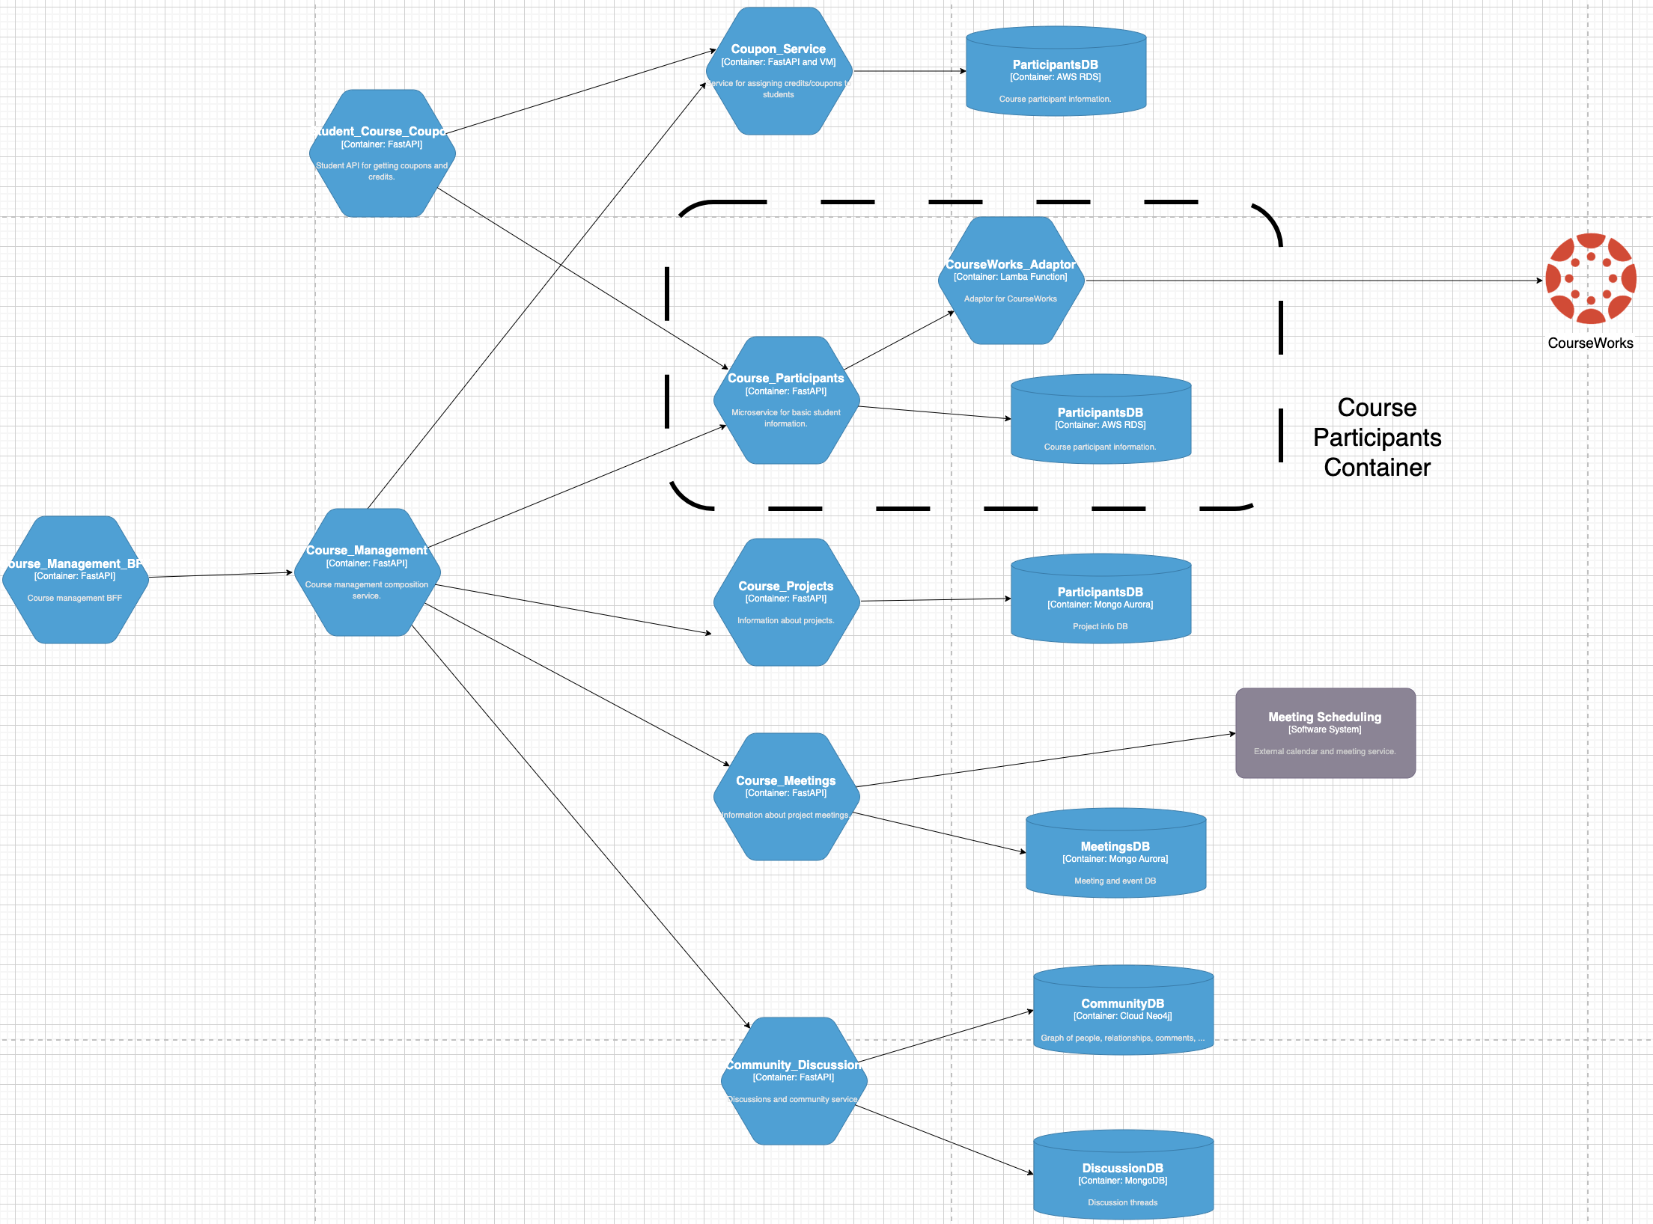
(Partial) Logical View – Interactive System
Some of the distinctions are arbitrary or in the ”eye of the beholder.”
System vs Container
Container vs Component
etc.
A container is not synonymous with a “Docker container.”
I have been in SW for 40 years and we still cannot define terms like “component.”
Just use common sense.
In general, containers in the cloud are microservices.”

Slide 30
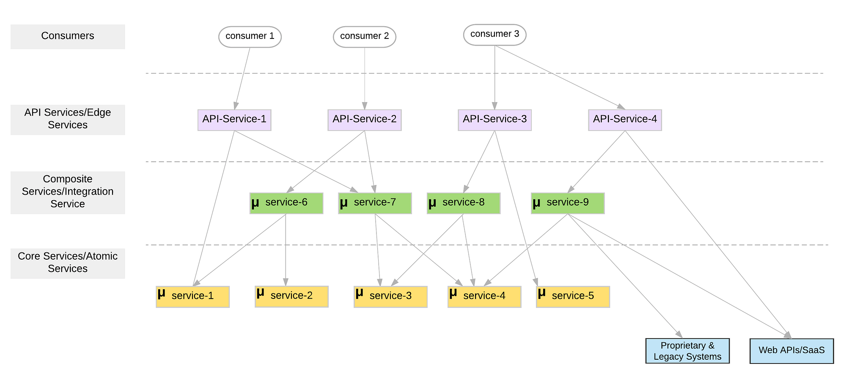
Our First Design Patterns: Adapter, Anti-Corruption
Adapter
Adapter

Slide 31
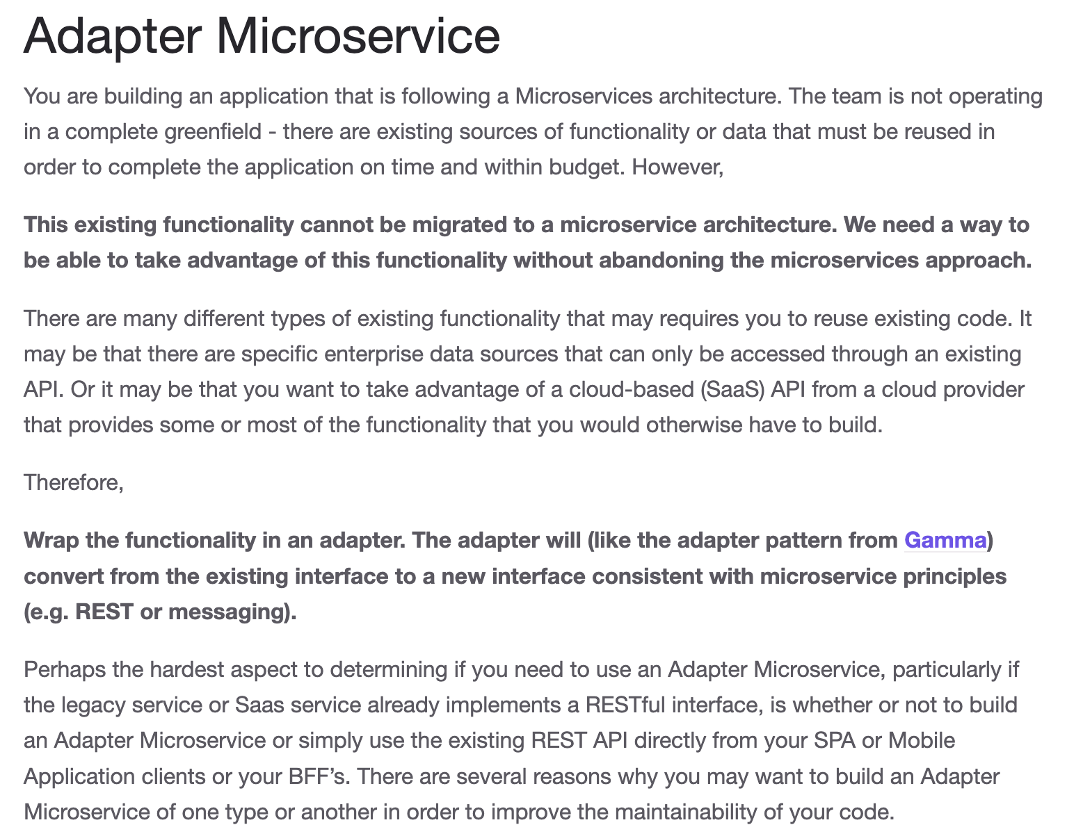
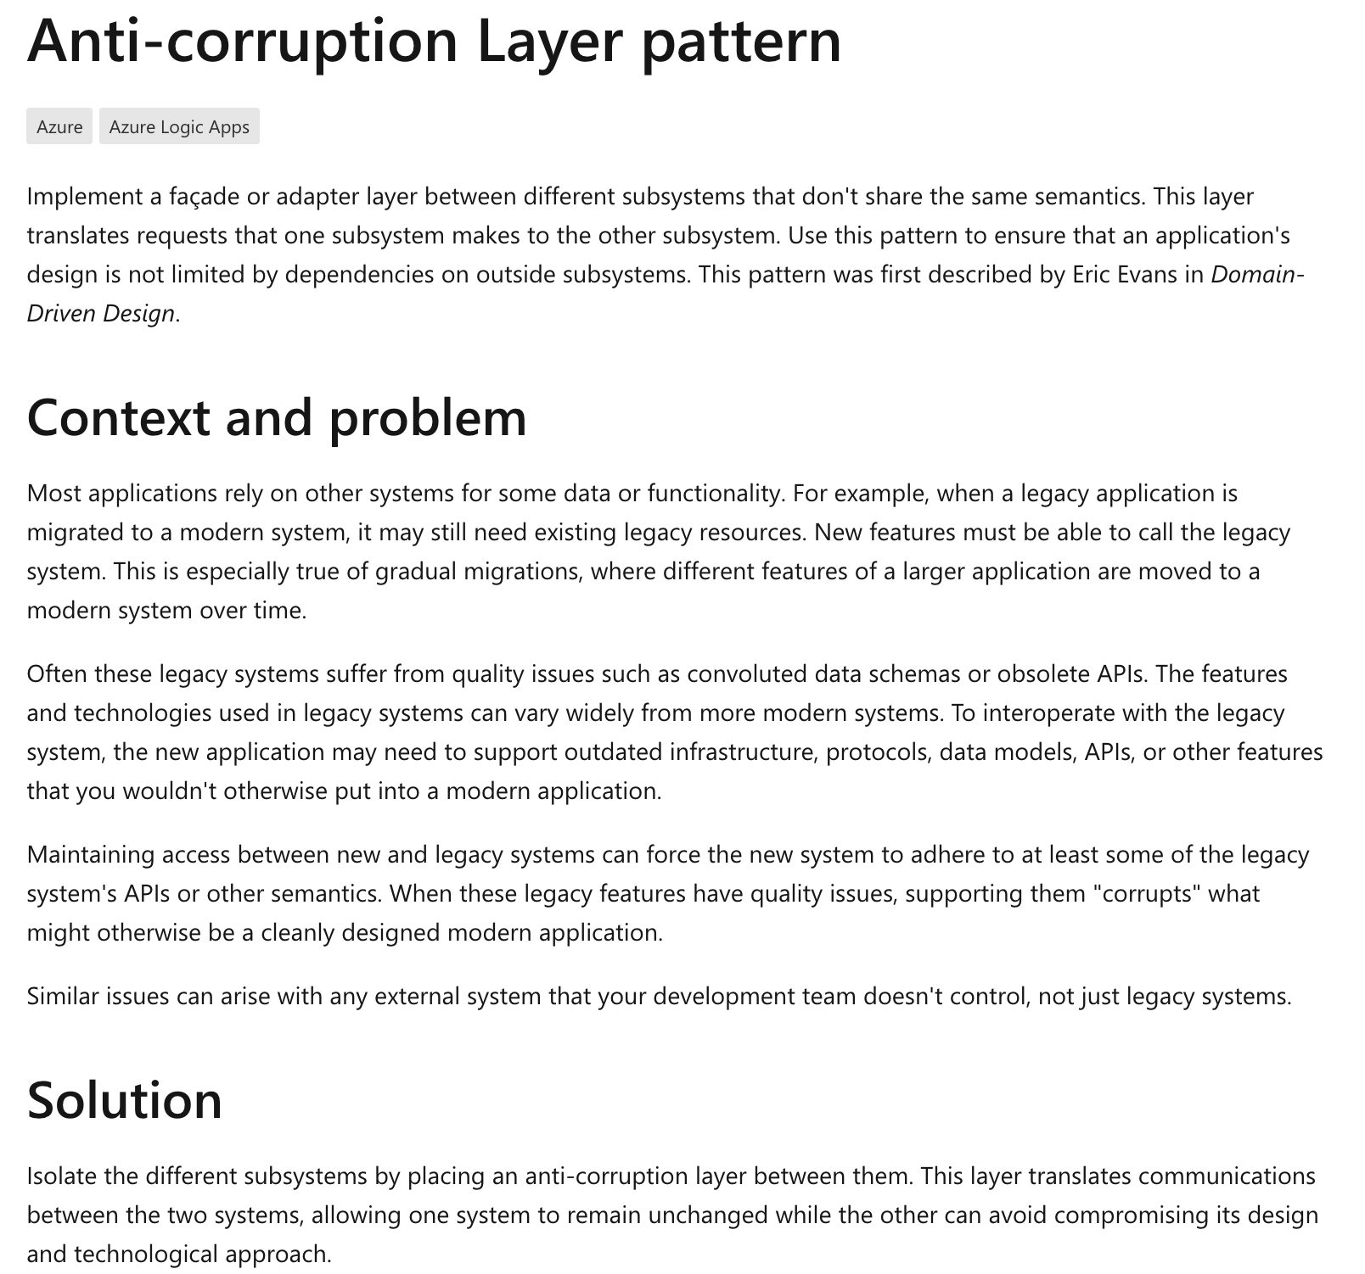
Adapter and Anti-Corruption
https://kgb1001001.github.io/cloudadoptionpatterns/
https://learn.microsoft.com/en-us/azure/architecture/patterns/anti-corruption-layer

Slide 32
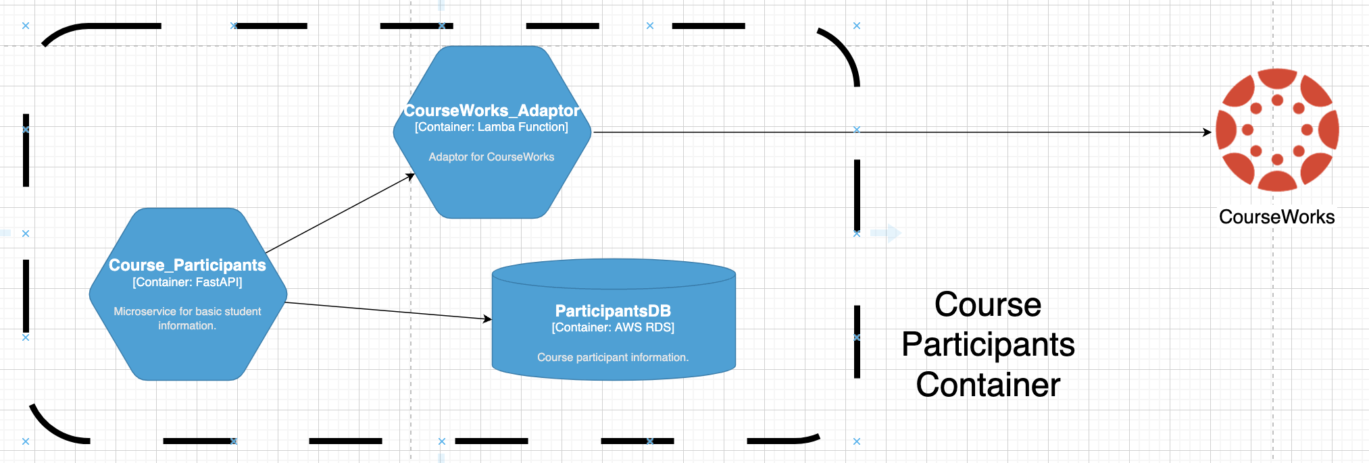
CourseWorks Adaptor
CourseWorks has an API. It is an HTTP based API. And is sort of “REST” like, but is kind of wonky. (https://canvas.instructure.com/doc/api/all_resources.html).
I want to define a preferred, canonical model for courses, sections, participants for my solution.
And map the model to CourseWorks, and have the option for changing.

Slide 33
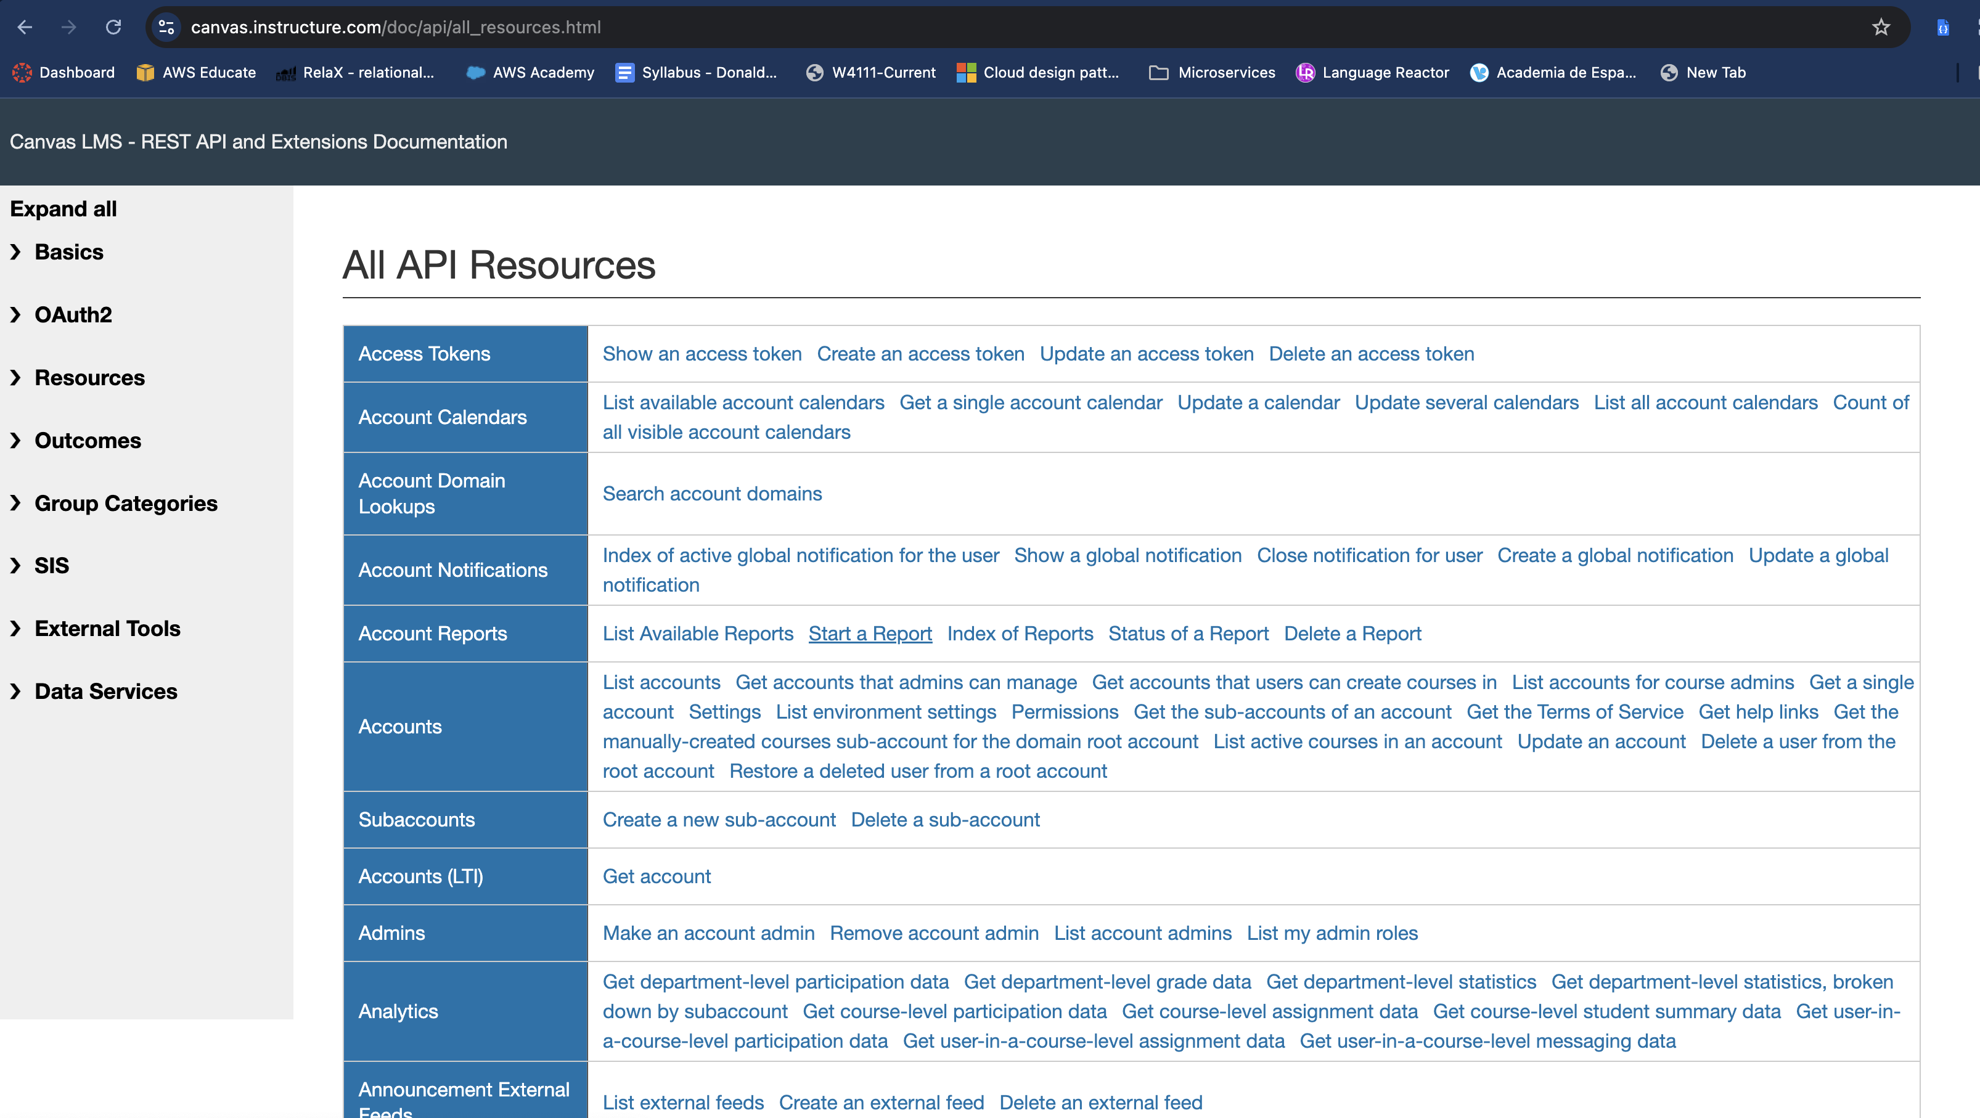
CourseWorks/Canvas LMS API

Slide 34
Applying Some Patterns/Principles
My first “real” microservice will initially demonstrate some concepts:
12 Factor App
Declare and isolate dependencies → requirements.txt
Store config in the environment → environment variables for API key, URLs
SOLID Principles
Single Responsibility → a microservice just focused on CourseWorks.
Interface Segregation → the service only exposes the APIs necessary for scenario.
Liskov Substitution → the service will have an OpenAPI definition, and the implementation can be substituted over time.
Design Patterns:
Adaptor
Anti-Corruption
But, my microservice exposes a REST API and I need to explain that first.

Slide 35
REST
35 | W4153-24F-L2-REST-Microservices-IaaS © Donald F. Ferguson, 2024

Slide 36
Concepts (Part 1)
Introduction
36 | W4153-24F-L2-REST-Microservices-IaaS © Donald F. Ferguson, 2024

Slide 37
REST (https://restfulapi.net/)
What is REST
REST is acronym for REpresentational State Transfer. It is architectural style for distributed hypermedia systems and was first presented by Roy Fielding in 2000 in his famous dissertation.
Like any other architectural style, REST also does have it’s own 6 guiding constraints which must be satisfied if an interface needs to be referred as RESTful. These principles are listed below.
Guiding Principles of REST
Client–server – By separating the user interface concerns from the data storage concerns, we improve the portability of the user interface across multiple platforms and improve scalability by simplifying the server components.
Stateless – Each request from client to server must contain all of the information necessary to understand the request, and cannot take advantage of any stored context on the server. Session state is therefore kept entirely on the client.
Cacheable – Cache constraints require that the data within a response to a request be implicitly or explicitly labeled as cacheable or non-cacheable. If a response is cacheable, then a client cache is given the right to reuse that response data for later, equivalent requests.
Uniform interface – By applying the software engineering principle of generality to the component interface, the overall system architecture is simplified and the visibility of interactions is improved. In order to obtain a uniform interface, multiple architectural constraints are needed to guide the behavior of components. REST is defined by four interface constraints: identification of resources; manipulation of resources through representations; self-descriptive messages; and, hypermedia as the engine of application state.
Layered system – The layered system style allows an architecture to be composed of hierarchical layers by constraining component behavior such that each component cannot “see” beyond the immediate layer with which they are interacting.
Code on demand (optional) – REST allows client functionality to be extended by downloading and executing code in the form of applets or scripts. This simplifies clients by reducing the number of features required to be pre-implemented.

Slide 38
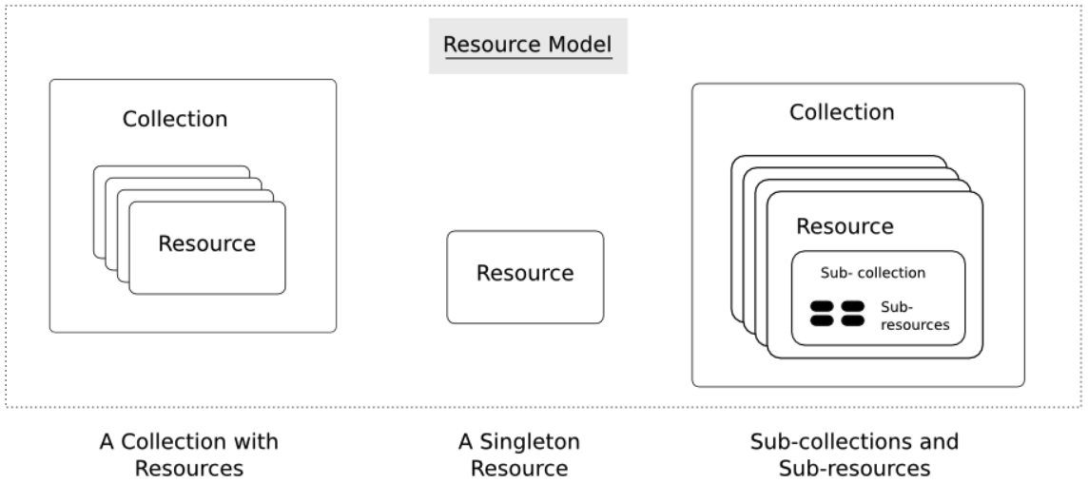
Resources
Resources are an abstraction. The application maps to create things and actions.
“A resource-oriented API is generally modeled as a resource hierarchy, where each node is either a simple resource or a collection resource. For convenience, they are often called a resource and a collection, respectively.
A collection contains a list of resources of the same type. For example, a user has a collection of contacts.
A resource has some state and zero or more sub-resources. Each sub-resource can be either a simple resource or a collection resource.
For example, Gmail API has a collection of users, each user has a collection of messages, a collection of threads, a collection of labels, a profile resource, and several setting resources.
While there is some conceptual alignment between storage systems and REST APIs, a service with a resource-oriented API is not necessarily a database, and has enormous flexibility in how it interprets resources and methods. For example, creating a calendar event (resource) may create additional events for attendees, send email invitations to attendees, reserve conference rooms, and update video conference schedules. (Emphasis added) (https://cloud.google.com/apis/design/resources#resources)
https://restful-api-design.readthedocs.io/en/latest/resources.html

Slide 39
REST – Resource Oriented
When writing applications, we are used to writing functions or methods:
openAccount(last_name, first_name, tax_payer_id)
account.deposit(deposit_amount)
account.close()
We can create and implement whatever functions we need.
REST only allows four methods:
POST: Create a resource
GET: Retrieve a resource
PUT: Update a resource
DELETE: Delete a resource
That’s it. That’s all you get.
A REST client needs no prior knowledge about how to interact with any particular application or server beyond a generic understanding of hypermedia.
“The key characteristic of a resource-oriented API is that it emphasizes resources (data model) over the methods performed on the resources (functionality). A typical resource-oriented API exposes a large number of resources with a small number of methods.” (https://cloud.google.com/apis/design/resources)

Slide 40
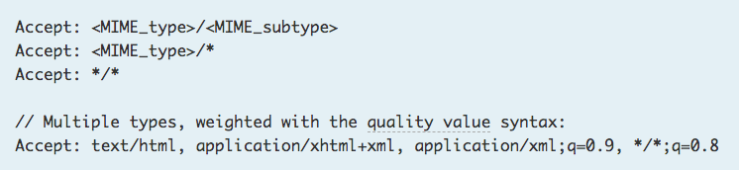
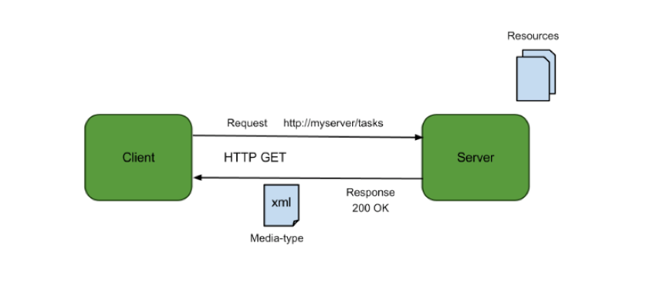
Resources, URLs, Content Types
Relative URL identifies “resource” on the server.
Server implementation maps abstract resource to tangible “thing,” file, DB row, … and any application logic.
Accept type in headers.
Client may be
Browser
Mobile device
Other REST Service
… …
Web media (content) type, e.g.
text/html
application/json

Slide 41
REST Principles
What about all of those principles?
Client/Server
Stateless
Cacheable
Uniform Interface
Layered System
Code on demand
Some of these principles
Are simple and obvious.
Are subtle and have major implications.
Stateless can be baffling, but we will cover later.
We will go into the principles in later lectures, ...
We will also go into HATEOAS, GraphQL, … …

Slide 42
Uniform Interface Resource Oriented (Also, Part 1)
Introduction
42 | W4153-24F-L2-REST-Microservices-IaaS © Donald F. Ferguson, 2024

Slide 43
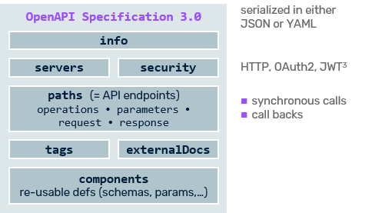
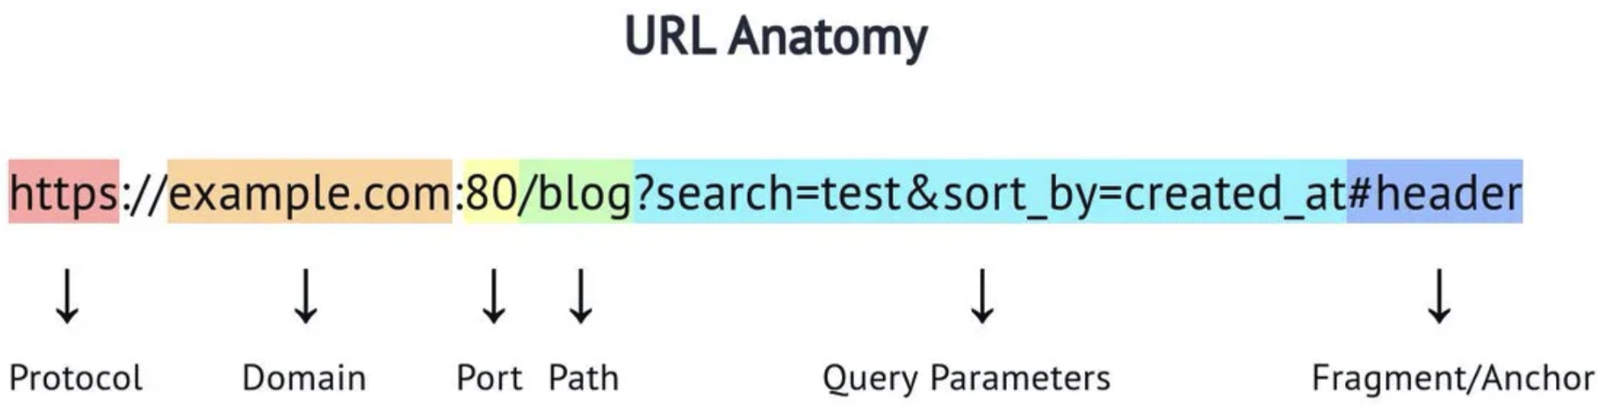
OpenAPI 3.0
OpenAPI is a standard for documenting REST APIs.
An HTTP request/response has several elements:
Protocol
Server address and port
Path
Query parameters
Fragment
Headers, Cookies
Body content and content type
Method
OpenAPI and web application frameworks introduce:
Path parameters
Models to represent bodies/content
Security information
Descriptive metadata

Slide 44
CourseWorks/Canvas LMS API
We have taken a quick look at the CourseWorks “as is” interface.
I have to define the “to be” resource model that I want my microservice to expose.

Slide 45
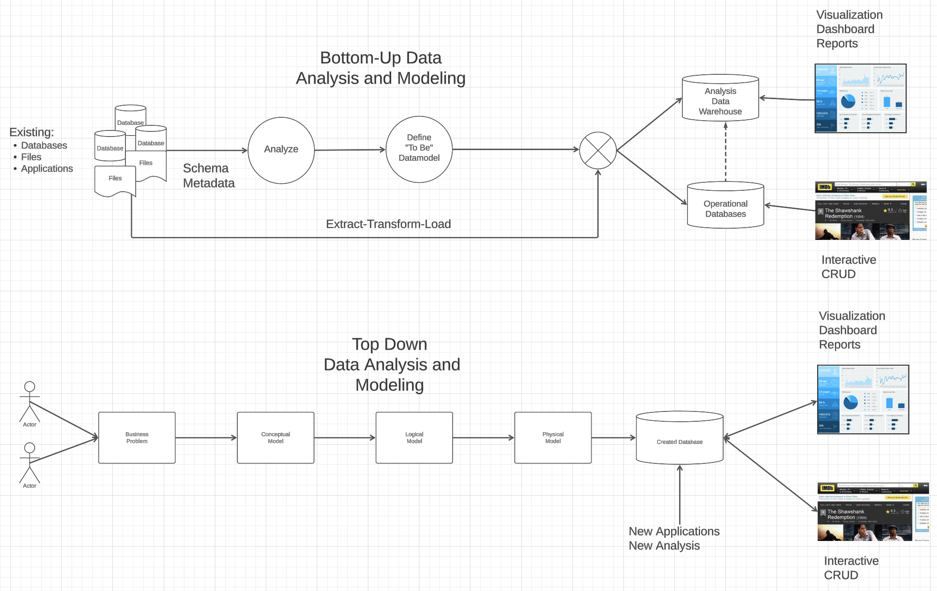
Top-Down, Bottom-Up, Meet-in-the-Middle
In my DB class, I cover:
Top-down data modeling
Bottom-up data modeling
An adaptor implements meet-in-the-middle and coverts
What exists to
What my application wants
REST talks about “resources.”
API design is similar to data modeling. Many concepts have analogs in REST.

Slide 46
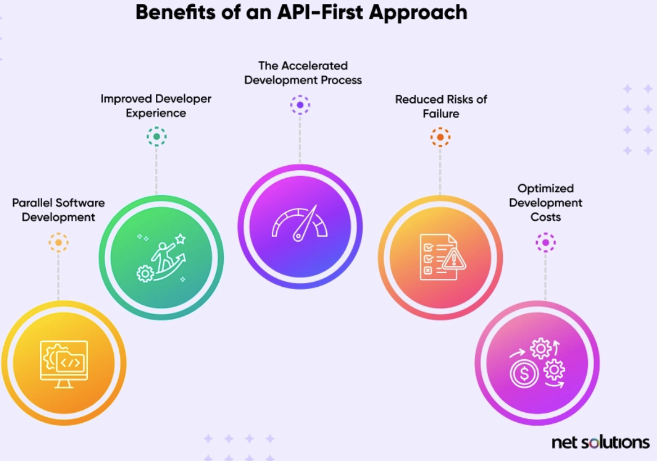
API First
“As the connective tissue linking ecosystems of technologies and organizations, APIs allow businesses to monetize data, forge profitable partnerships, and open new pathways for innovation and growth.” (McKinsey)
“API-first, also called the API-first approach, prioritizes APIs at the beginning of the software development process, positioning APIs as the building blocks of software. API-first organizations develop APIs before writing other code, instead of treating them as afterthoughts. This lets teams construct applications with internal and external services that are delivered through APIs.” (https://www.netsolutions.com/hub/mach-architecture/api-first)
Why API-First Approach?
By defining the APIs first, there is a modular separation between the services in the system. This increases the reusability of API endpoints across different parts of the system and to external entities as well (Interoperability).
The API-first approach promotes collaboration as API documentation and contract definitions serve as a common language for stakeholders such as different teams in development (e.g. frontend and backend), V&V teams for test scenarios, etc.
Creating the API contracts as part of the API-first design approach can be shared with frontend teams where the team can start building user interfaces parallelly with mocked data as per contract models, tested for the user experience. Also, codegen can be used to generate client mocks which can be directly used by client apps such as iOS/Android, etc.
It gives the flexibility for tech-stack choices. Different services or applications in the system can be in different languages as long as they adhere to API contracts. It can help in identifying the best suitable tools/options in terms of cost and performance.
With the API-First approach many concerns such as security measures, versioning, request traffic and data volume, and Integration with different services/applications within the system.
https://medium.com/@rohitranjan.pandey/api-first-design-approach-swagger-a1423db48f76

Slide 47
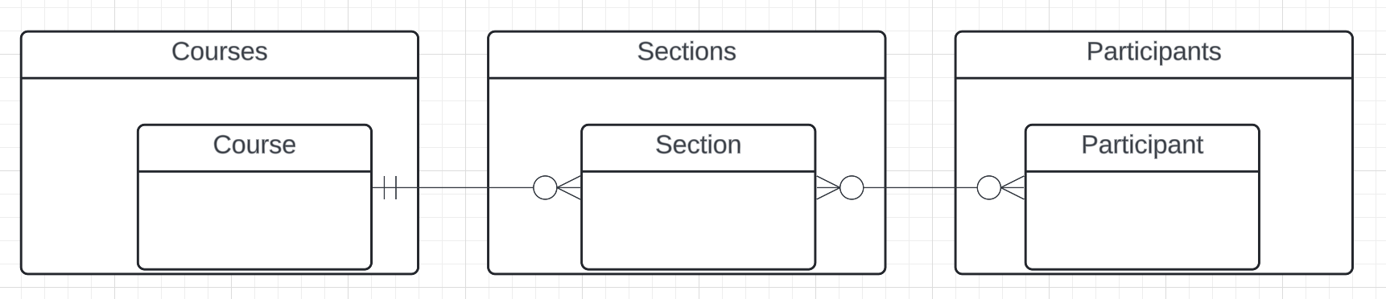
Resources and APIs
Base resources, paths and methods:
/courses: GET, POST
/courses/<id>: GET, PUT, DELETE
/sections: GET, POST
/sections/<id>: GET, PUT, DELETE
/participants: GET, POST
/participants/<id>: GET, PUT, DELETE
There are relative, navigation paths:
/courses/<id>/sections
/participants/<id>/sections
etc.
GET on resources that are collections may also have query parameters.
There are two approaches to defining API
Start with OpenAPI document and produce an implementation template.
Start with annotated code and generate API document.
In either approach, I start with models.
Also,
I lack the security permission to update CourseWorks.
I can choose to not surface the methods or raise and exception.

Slide 48
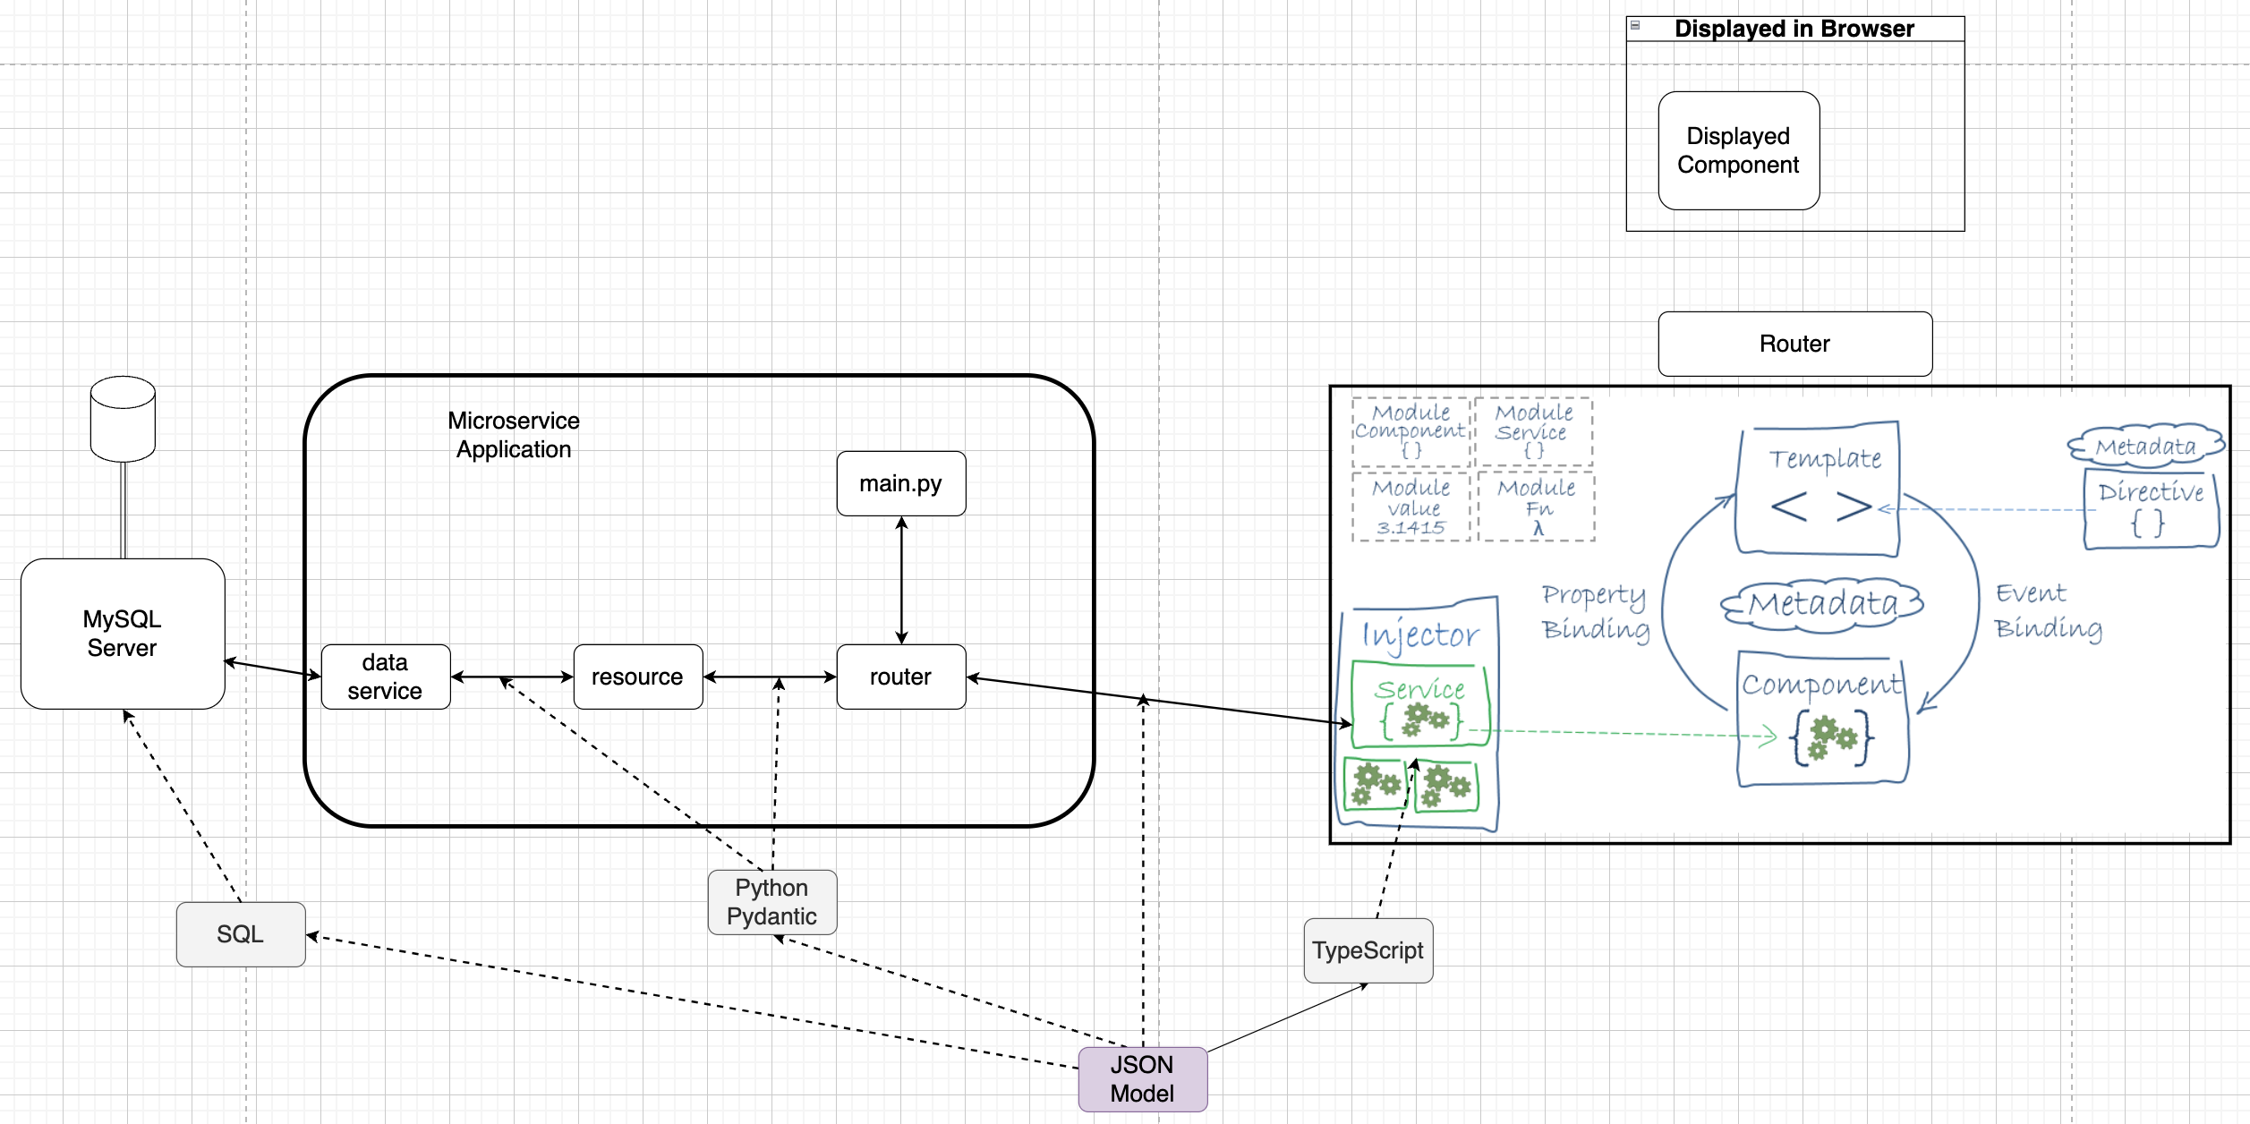
Full Stack Application Structure
GitHub Project
Web UI Repo
https://medium.com/@bhavikagarg8/angular-architecture-overview-1e7cc7483a0
Microservice Repo
Data Repo

Slide 49
Quick, First Code Walkthrough
Introduction
49 | W4153-24F-L2-REST-Microservices-IaaS © Donald F. Ferguson, 2024

Slide 50
First Iteration
Core project: /Users/donald.ferguson/Dropbox/000/00-Current-Repos/student-course-application/courseworks-adaptor-service
This is currently some pretty awful code.
The pydantic stuff drives me crazy.
My first object model is not quite correct … …
Participant and “Person” are not quite the same thing. A participant is a “relationship.”
Some of the properties are “munged together.” There really is not “course” in CourseWorks, for example. All they have are sections.
… …
The way that I evolve this, or partially evolve this, is
Start with a simple mockup and consumers can use.
Continuously evolve.
And I have to solve some other problems, like … … configuration from the environment.
… …

Slide 51
BLOBs, Static Content
51 | W4153-24F-L2-REST-Microservices-IaaS © Donald F. Ferguson, 2024

Slide 52
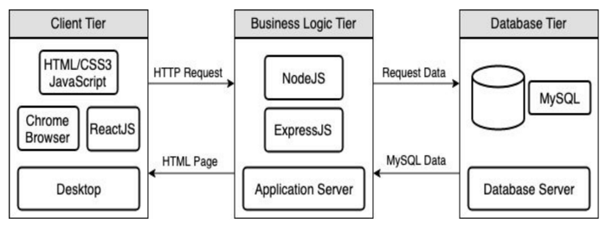
Full Stack Web Application – Reminder
https://levelup.gitconnected.com/a-complete-guide-build-a-scalable-3-tier-architecture-with-mern-stack-es6-ca129d7df805
We have seen how to use Flask (or FastAPI) to implement an endpoint (a set of paths):
Some of the paths can run application logic and return the result data.
Some can return pages that a browser can render. Basically, these paths are returning the “client application” to the browser to execute, and may have API calls in JavaScript/Typescript.
Do not worry about this now.
But, running application logic and simply delivering files are two different “concerns.”
Having one runtime implement both would violate the SOLID principle.
The design points are different: “You can be a floor wax or a mouth wash, but not both.”
So, we need a separate “web server.”

Slide 53
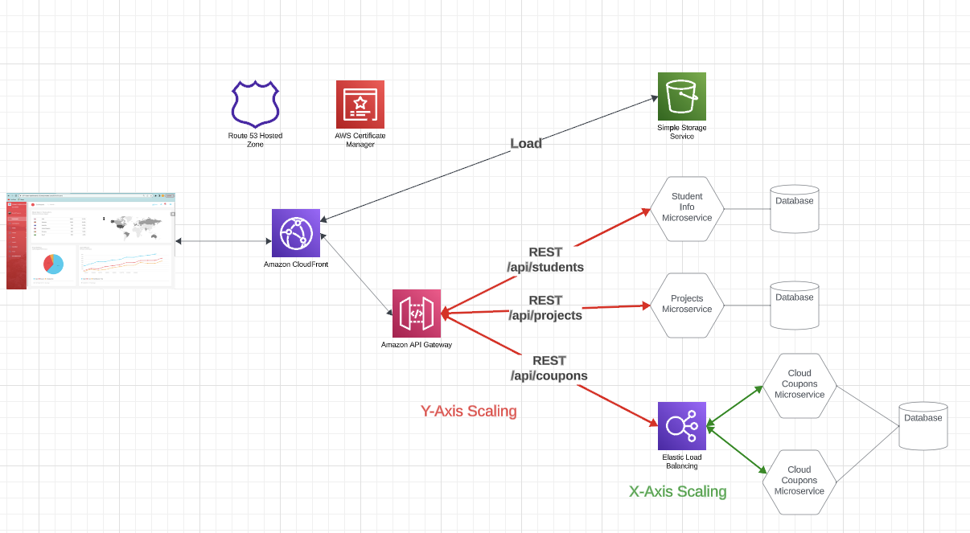
Reminder and Positioning
Explaining:
S3 and web hosting.
CloudFront:
Domain
Single site

Slide 54
BLOB: Binary Large Object
Definitions:
“A binary large object (BLOB or blob) is a collection of binary data stored as a single entity. Blobs are typically images, audio or other multimedia objects, though sometimes binary executable code is stored as a blob. They can exist as persistent values inside some databases or version control system, or exist at runtime as program variables in some programming languages.” (https://en.wikipedia.org/wiki/Binary_large_object)
“Blob is the data type in MySQL that helps us store the object in the binary format. It is most typically used to store the files, images, etc media files for security reasons or some other purpose in MySQL.” (https://www.educba.com/mysql-blob/)
Intent:
File systems are not good for many application scenarios, which is why database management systems emerged.
Database management systems implement structured (or semi-structured) data, e.g. tables.
Database BLOBs were a way to have some “big things” as table or document properties.

Slide 55
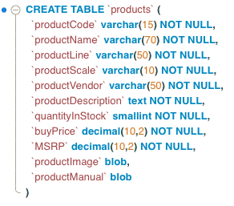
Simple Example
Structured or semi-structured information about an entity.
Queryable
Editable on forms
etc.
Unstructured: A file-like, opaque property associated with the entity. This is a BLOB.
URLs have primarily replaced BLOBs.

Slide 56
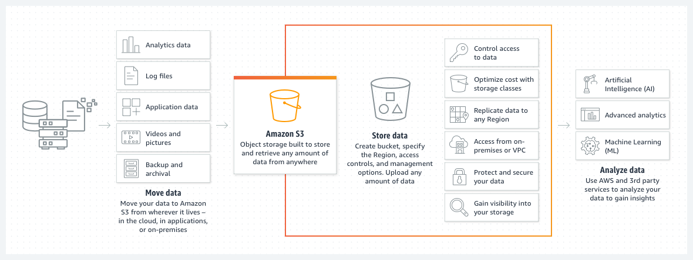
Amazon S3
We used the equivalent capability on Azure for uploading CAD files, storing processed files and results, etc.

Slide 57
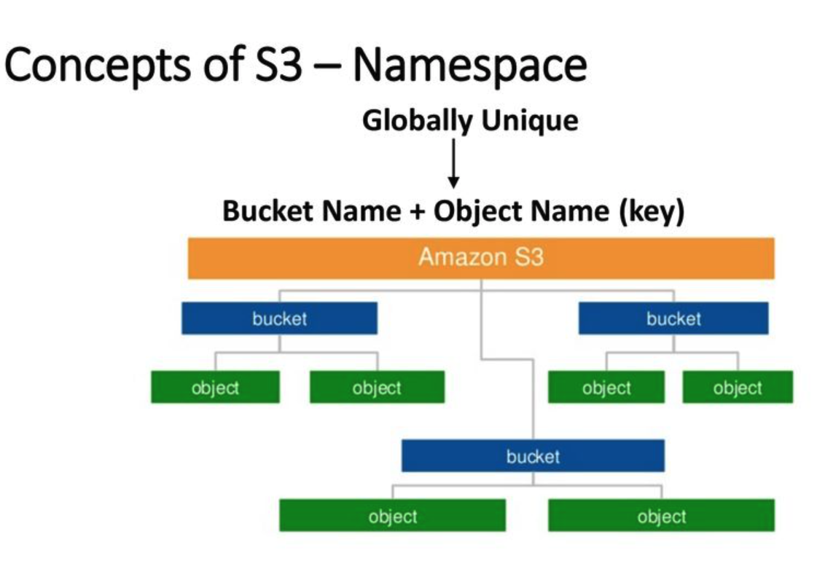
AWS S3
Can support a logical hierarchy with a convention on keys.
x/y
x/z
x/y/z
... ...
Acts kind of file system like, but is really just key strings.

Slide 58
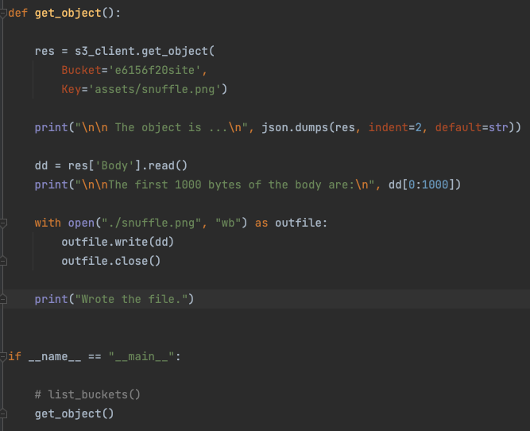
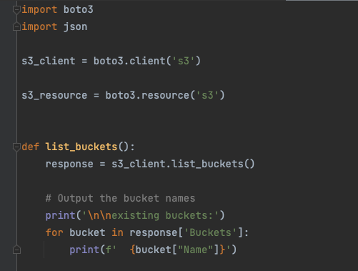
Simple S3 Example
/Users/donaldferguson/Dropbox/00NewProjects/e6156examples/s3/s3_examples.py

